Slide 1

LECTURE 3: Agent Architectures
KD04603 Intelligent Agents
Taken and modified from “An Introduction to MultiAgent Systems” by Michael Wooldridge, John Wiley & Sons, 2009, COMP310 course of UoL by Terry Payne and “Agent Technology for e-Commerce” by Maria Fasli
KK04203 Intelligent Agents

Slide 2
Expected learning outcomes
Understand the abstract architectures of an agent
Understand different elements of agent architectures
KK04203 Intelligent Agents

Slide 3
Outline
Abstract architecture for agents
Agent architectures
Pure reflex
Agent with state
Goal based
Utility based
BDI
Hybrid
KK04203 Intelligent Agents

Slide 4
Basic characteristics of an agent
Reactive – respond to changes occur in time
Proactive – taking the initiative
Social ability - the ability to interact with other agents

Slide 5


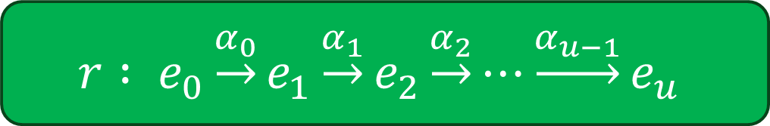
Abstract Architecture for Agents
Assume the environment may be in any of a finite set E of discrete, instantaneous states:
Agents are assumed to have a repertoire of possible actions available to them, which transform the state of the environment:
A run, r, of an agent in an environment is a sequence of interleaved environment states and actions:
KK04203 Intelligent Agents

Slide 6
Abstract Architecture for Agents
Agent is a function which maps runs (percept histories) to actions:
[f: P* → A]
An agent makes a decision about what action to perform based on the history of the system that it has witnessed to date
KK04203 Intelligent Agents

Slide 7
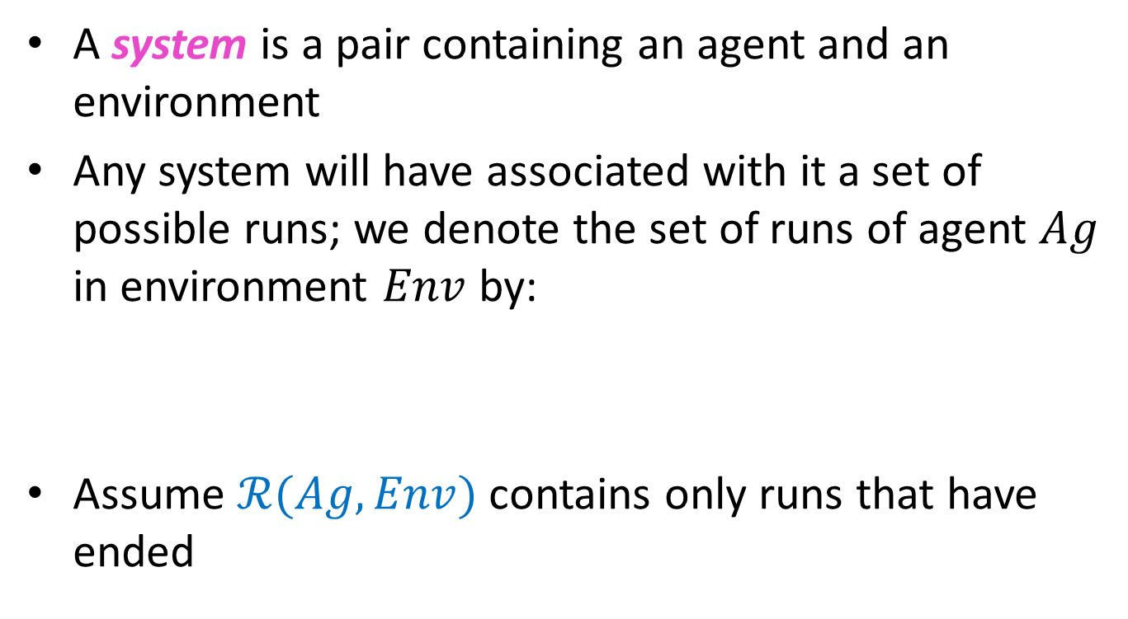

Systems
KK04203 Intelligent Agents

Slide 8
Agent Architectures
Purely reactive
Agent with state
Goal based
Utility based
Belief-Desire-Intention
Hybrid
Russel and Norvig (2010), Wooldridge (2009)
Fasli (2007)
KK04203 Intelligent Agents

Slide 9
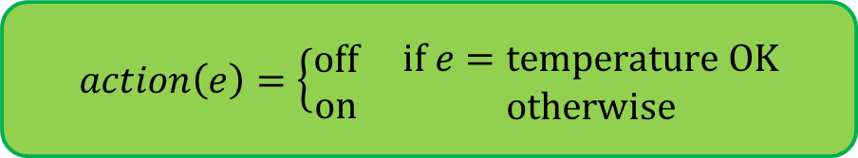
(1) Purely Reactive Agents
Some agents decide what to do without reference to their history – decision made based on the present only
Known as purely reactive agent
A thermostat is a purely reactive agent
Also known as simple reflex agent
KK04203 Intelligent Agents

Slide 10
Purely reactive agent
Agent
percept
Percept-1 > action-1
Percept-2 > action-2
…
Percept-n > action-n
Current state of the world.
environment
action
What action should I do now?
Condition-Action Rules
KK04203 Intelligent Agents

Slide 11
(2) Agent with state
We now consider agents that maintain state:
Agent
see
action
next
state
Environment
KK04203 Intelligent Agents

Slide 12
Agent with state
Have internal structure to record information about the environment state and history
Keep track of the world state

Slide 13
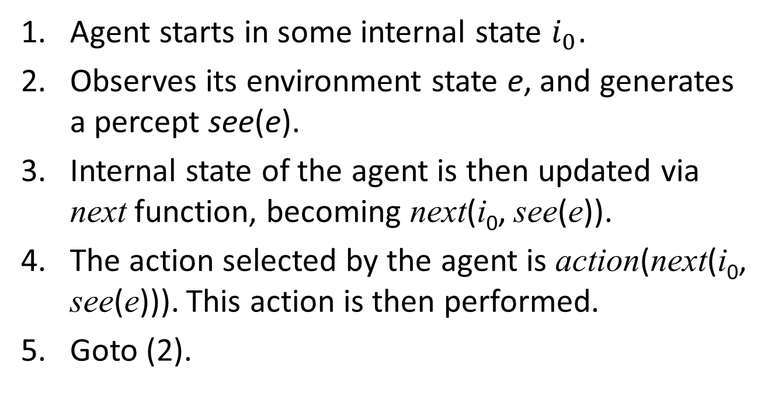
Agent with State Control Loop
KK04203 Intelligent Agents

Slide 14
(3) Goal based
Goal based agent is one which choose its actions in order to achieve goals.
The agents uses goal information to select between possible actions in the current state.
Two aspect of goal based agents are searching and planning.
Example : A GPS system finding a path to certain destination
Notes:
https://www.quora.com/What-are-goal-based-agents

Slide 15
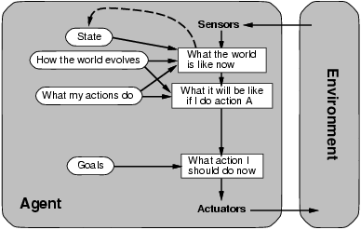
(3) Goal based
KK04203 Intelligent Agents

Slide 16
Tasks for Agents
We build agents in order to carry out tasks for us (goal based agent)
The task must be specified by us…
But we want to tell agents what to do without telling them how to do it
How can we make this happen?
KK04203 Intelligent Agents

Slide 17
(4) Utility based Agents
One possibility: associate utilities with individual states — the task of the agent is then to bring about states that maximize utility
Utility function provides performance measure of how efficiently each action achieves the goal
KK04203 Intelligent Agents
Notes:
Utility-based agents are a type of artificial intelligence (AI) that make decisions based on the expected utility of different actions. Utility refers to the measure of the desirability or usefulness of an action or outcome. Utility-based agents evaluate the potential outcomes of different actions and choose the one that is expected to maximize their utility.
For example, a utility-based agent in a game might evaluate different moves based on the expected utility of each move, taking into account factors such as the likelihood of winning the game and the potential rewards or penalties associated with different actions. The agent would then choose the move that is expected to maximize its utility, based on the available information and its pre-defined utility function.
Utility-based agents are used in a variety of applications, including decision-making, planning, and problem-solving. They can be designed to optimize for specific objectives, such as maximizing rewards or minimizing risks. Unlike some other AI approaches, utility-based agents can explicitly take into account the desirability of different outcomes, making them well-suited for decision-making tasks.

Slide 18
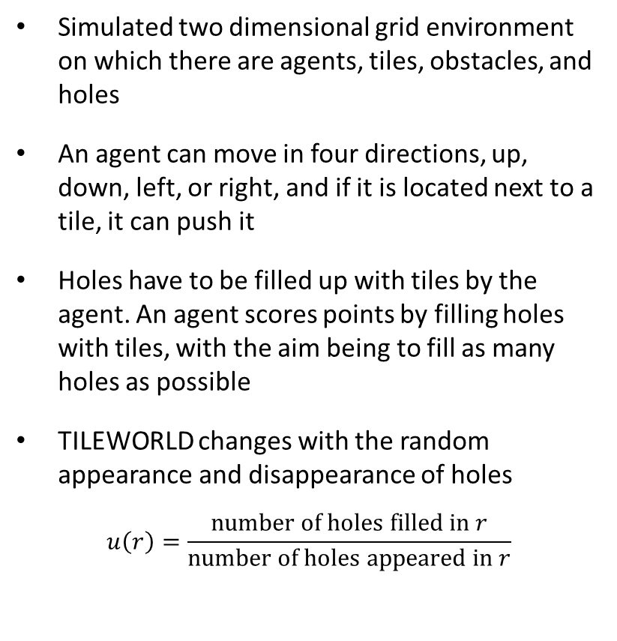
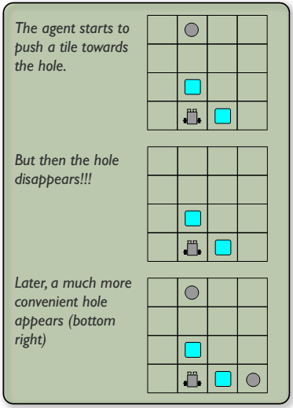
Utility in the Tileworld
KK04203 Intelligent Agents

Slide 19
(5) Belief-Desire-Intention Architecture
Based on Bratman’s (1987) philosophical theory of practical reasoning
Theoretical reasoning: reasoning based on beliefs and knowledge
Practical reasoning: deciding what to do
Deliberation: deciding what to achieve
Means-end reasoning (or planning): deciding how to achieve it
Beliefs: an agent’s information about the world
Desires: an agent’s motivation or possible options
Intentions: an agent’s commitments
KK04203 Intelligent Agents

Slide 20
Intentions
Intentions are key in practical reasoning:
They describe states of affairs that the agent has committed to bringing about and as a result they are action-inducing
They resist reconsideration, are volitional and reasoning-centered, and one intention leads to further being generated
Forming intentions is critical to an agent’s success
Resource bound (fixed amount of power, memory)
Cannot continually weigh its options
KK04203 Intelligent Agents

Slide 21
BDI Components
Deliberation
Planning
KK04203 Intelligent Agents

Slide 22
BDI Components
Belief revision function – update the agent’s current belief based on new percept
Set of beliefs – agent’s current information for the world
Generate options – determine the agent’s options or desires
Set of desires – possible options for the agent
Filter function – deliberation process; deciding what to do

Slide 23
BDI Components
Set of current intentions – what the agent has chosen to do
Action selection function – select action based on the current set of intentions

Slide 24
Agent control loop
begin
B:=B₀; // initial beliefs
I:=I₀; // initial intentions
while true do
p:=get-percept();
B:=brf(B,p); // update beliefs
D:=options(B,I); // generate options
I:=filter(B,D,I); // determine intentions
action:=asf(I); // select an intention to be executed
execute(action);
end-while
end
KK04203 Intelligent Agents

Slide 25
Implementation of BDI
Goal 1
Goal 2
Observes the world
Update beliefs
Deliberates to decide what intention to achieve
Uses mean-ends reasoning to find a plan to achieve the intentions
Executes the plan
P1.b
Mean-ends reasoning
P1.a
p1
deliberation
p2
KK04203 Intelligent Agents

Slide 26
(6) Hybrid
Combine reactive and deliberative components and form a hierarchy of interacting layers
At least two layers (reactive/ proactive)
Each layer reasons at a different level of abstraction
Two types of layering:
Horizontal layering
Vertical layering
KK04203 Intelligent Agents

Slide 27
Horizontal layering
Fault tolerance!!
Each layer can act as an independent agent
n layer = n behaviours
Layer n
Sensory input
Action output
……
Layer 2
Layer 1
The layers compete with each other in order to take control of the agent
Problems???
Incoherent behaviour!!!
KK04203 Intelligent Agents

Slide 28
Mediator Function
Consistency can be achieved by introducing a function which achieves mediation between the layers
Mediator function is exponentially complete: if there are n layers capable of suggesting m actions, then there are m^{n} interactions
However, the mediator function can introduce a bottleneck into the agent’s decision making
KK04203 Intelligent Agents

Slide 29
E.g. TouringMachines
Consists of three activity producing layers (reactive, planning and modelling)
Each layer produces suggestions of what actions need to be performed by the agent
KK04203 Intelligent Agents

Slide 30
TouringMachines
Modeling layer
Sensory
input
Planning layer
Action
output
Rule-1: kerb-avoidance
if
is-in-front(Kerb, Observer) ˄ speed(Observer)>0 ˄ separation(Kerb, Observer) < KerbThreshold
then
change-orientation(KerbAvoidanceAngle)
Reactive layer
Responds to changes as they occur
Implemented through situation-action rules
Control rules
KK04203 Intelligent Agents

Slide 31
TouringMachines
Modeling layer
Sensory
input
Planning layer
Action
output
Achieves the agent’s pro-active behaviour
Uses library of plan skeletons or schemas
Each schema contains sub-goals
Reactive layer
Control rules
KK04203 Intelligent Agents

Slide 32
TouringMachines
Represents various entities in the world (e.g. the agent and other agents)
Predicts conflicts between agents and generates new goals
Modeling layer
Sensory
input
Planning layer
Action
output
Reactive layer
Control rules
KK04203 Intelligent Agents

Slide 33
Modeling layer
Sensory
input
Planning layer
Action
output
Censor-rule-1:
if
entity(obstacle-6) in perception-buffer(layer-R)
then
remove-sensory-record(layer-R, entity(obstacle-6))
Reactive layer
Decides which layers control the agent
Implemented as a set of rules
Control rules
KK04203 Intelligent Agents

Slide 34
Vertical layering
Not fault tolerance!!
Action output
Layer n
Layer n
Layer 2
Layer 2
Layer 1
Layer 1
Sensory
input
Action
output
Sensory input
One-pass
Two-pass
KK04203 Intelligent Agents

Slide 35
Vertical layering
Advantages
Low complexity. If there are n layers there are n-1 interfaces between them. If each layer is capable of suggesting m possible actions then there are at most m²(n-1) interactions
No central control, no bottleneck in the agent’s decision making
Problems
Less flexible
Not fault tolerant
KK04203 Intelligent Agents

Slide 36
Summary
Abstract architectures of agents have been described
Six different architectures were presented:
Pure reflex
Agent with state
Goal based
Utility based
BDI
Hybrid
What’s next?
Multi-Agent Systems (MAS)
KK04203 Intelligent Agents

